Slide 1
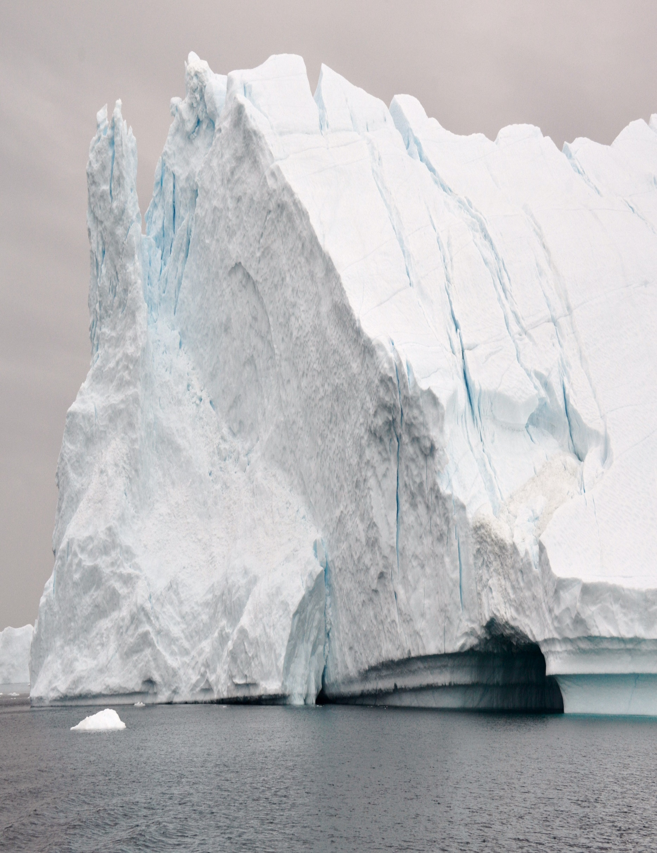
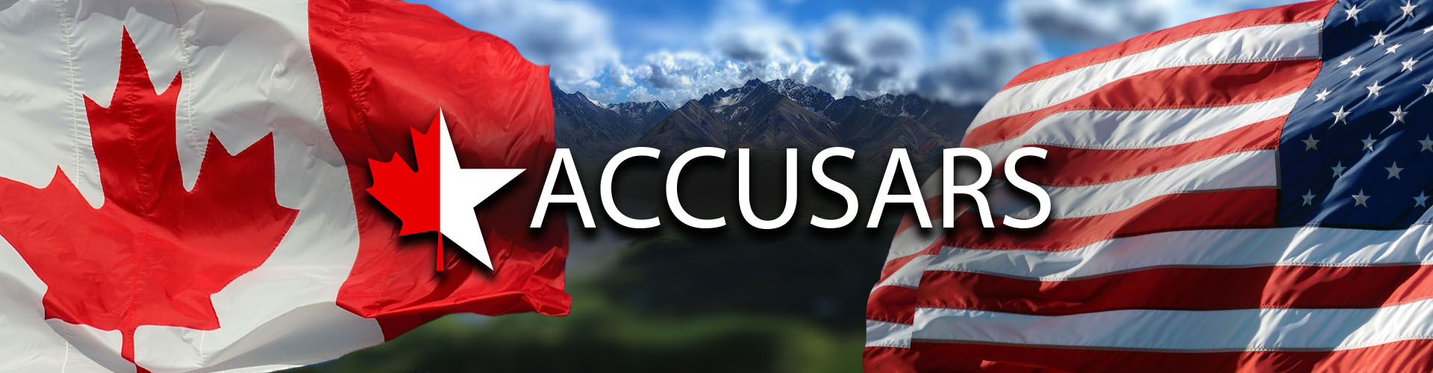

In support of the North American and Arctic Defense and Security Network (NAADSN)
Welcome Arctic minded Professionals to
Advancing Collaboration in Canada-U.S. Arctic
Regional Security II (ACCUSARS II)
A Strategic Foresight Exercise Sequel
Specifically, oriented for the U.S. and Western Canadian Arctic Regions
25 March 2021
Continuing from ACCUSARS I, ACCUSARS II seeks to examine the emerging trends in the medium- and long-term aspects in the North American Arctic security environment to create a useful Strategic Foresight Assessment oriented to the U.S. and Western Canadian Arctic regions (Alaska, Yukon and Northwest Territories).
Via gathering of academics and practitioners at this workshop, organizers will seek to anticipate potential North American Arctic futures using SFA methods to better identify and codify the understood capability gaps and shortfalls in identifying future risks, challenges and opportunities across Canada-U.S. security collaboration to better protect Canada and U.S. sovereign interests in the Arctic.
Workshop Hosts

Slide 2
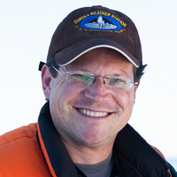
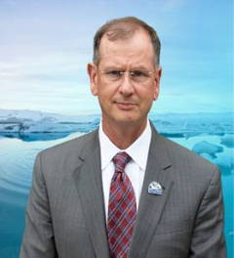
In support of the North American and Arctic Defense and Security Network (NAADSN)
0730-0745 AST/0930-0945 MST/1130-1145 EST:
Welcome and orientating remarks. Administrative remarks by Dr. Whitney Lackenbauer, Network Lead, North American Arctic Defence and Security Network, Trent University, and Maj Gen (Ret), Church Kee, USAF, Executive Director, Arctic Domain Awareness Center, University of Alaska.
Note: All ACCUSARS II Materials are located at https://arcticdomainawarenesscenter.org/EventHub_ACCUSARS-II

Slide 3
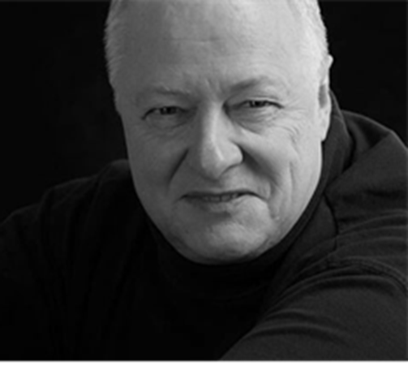
In support of the North American and Arctic Defense and Security Network (NAADSN)
0745-0810 ADT/0945-1010 MDT/1145-1210 EDT
Opening Address. Understanding the developing landscape of the North American Arctic. Mr. Tony Penikett, former Premier of Yukon, currently affiliated with Simon Fraser University, Vancouver, British Columbia.

Slide 4
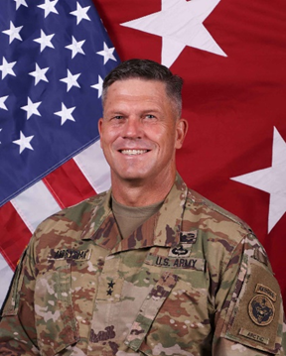
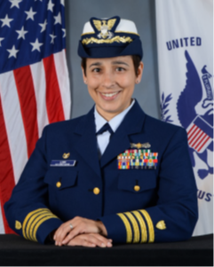
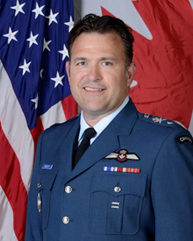
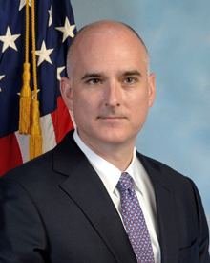
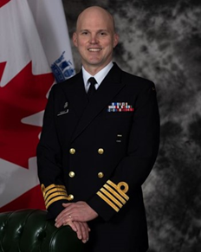
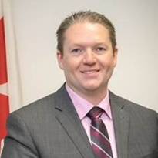
In support of the North American and Arctic Defense and Security Network (NAADSN)
0810-0920 ADT/1010-1120 MDT/1210-1320 EDT
ACCUSARS II Panel #1. Unclassified Trends in developing Arctic security risks to the Arctic, with a specific focus towards Alaskan and Western Canadian Arctic region: What is common and what is distinct?
Panel Moderator: Church Kee
Panelists:
MG Peter Andrysiak, USA, Deputy CDR, ALCOM and CDR, USARAK, Joint Base Elmendorf-Richardson, Alaska.
CAPT Leanne Lusk, Commander, USCG D17 Sector Anchorage, Joint Base Elmendorf-Richardson, Alaska.
BGen F.W. Radiff, RCAF, Canadian deputy, Alaska NORAD Region, Joint Base Elmendorf-Richardson, Alaska. (Representative for Federal Bureau of Investigation Anchorage Alaska.
Mr. Shawn Peters, Assistant Special Agent in Charge, Bureau of Investigation Anchorage Alaska.
CAPT (Navy) Jake French, RCN, Deputy Commander, Joint Task Force North, Yellowknife Northwest Territories (NWT).
Assistant Commissioner, Arctic Region, Neil O’Rourke, Canadian Coast Guard, Yellowknife, NT.

Slide 5
In support of the North American and Arctic Defense and Security Network (NAADSN)
0920-0930 ADT/1120-1130 MDT/1320-1330 EDT
Break

Slide 6
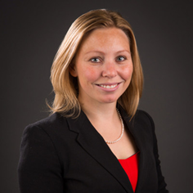
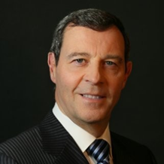

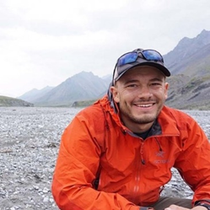
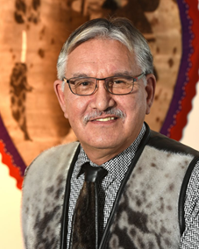
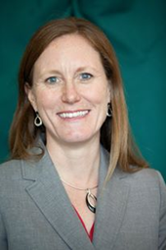
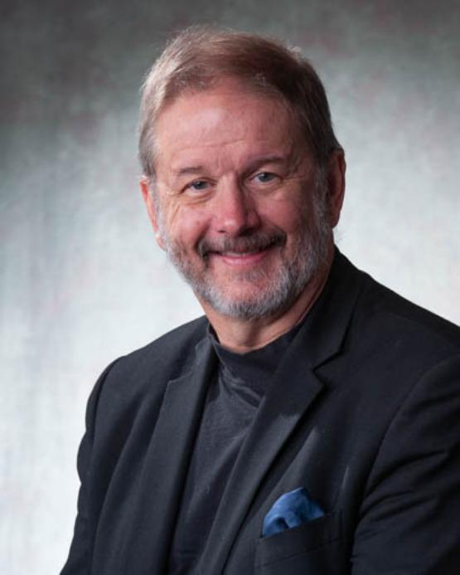
In support of the North American and Arctic Defense and Security Network (NAADSN)
0930-1040 ADT/1130-1240 MDT/1330-1440 EDT
ACCUSARS II Panel #2. The Arctic Economic Security Environment: Navigating Uncertainty
Panel Moderator: Whitney Lackenbauer
Panelists:
Dr. Heather Exner-Pirot, Member of the Saskatchewan Indigenous Economic Development Network and a Senior Consultant with Morris Interactive, Calgary, Alberta.
Mr. Taylor Holshauser, Director of Business Development, Alaska Ocean Cluster.
Mr. David Clarke, President and Chief Operating Officer, Qilak LNG, LLC, Anchorage, Alaska.
Mr. Harry Flaherty, President & CEO, President and CEO of Qikiqtaaluk Corporation, Iqaluit, Nunavut.
Ms. Christi Bell, Executive Director, Business Enterprise Institute, University of Alaska Anchorage, Anchorage Alaska.
Dr. Rob Huebert, University of Calgary, Alberta

Slide 7
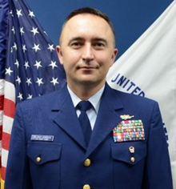

In support of the North American and Arctic Defense and Security Network (NAADSN)
1040-1100 ADT/1240-1300 MDT/1440-1500 EDT
Introduction to Strategic Foresight Activity. Orientation by CDR Aaron Delano-Johnson, USCG and LCDR Ryan Hawn, USCG HQ USCG DCO-X (Evergreen), Washington D.C.

Slide 8
In support of the North American and Arctic Defense and Security Network (NAADSN)
1100-1110 ADT/1300-1310 MDT/1500-1510 EDT
Break

Slide 9
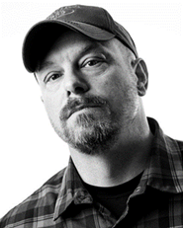
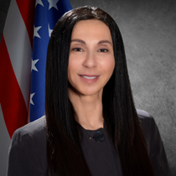
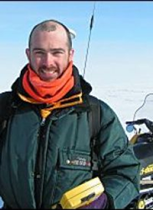

In support of the North American and Arctic Defense and Security Network (NAADSN)
1110-1220 ADT/1310-1420 MDT/1510-1620 EDT
Strategic Foresight Activity. Converting Themes and Trends into Indicators of Threat/Risk
In four (4) planned breakout groups, ACCUSARS participants will assess regional components of the North American Arctic defence/defense and security implications of one theme (political, human, economics/resources, and environment) in detail.
  Group 1: Political aspects - Moderated by Troy Bouffard, CASR, University of Alaska Fairbanks, Fairbanks Alaska.
  Group 2: The Roles of Remote Communities - Moderated by Dr. Lil Alessa, President’s Professor, University of Idaho, Moscow Idaho.
  Group 3: Environmental aspects - Moderated by Dr. Craig Tweedie, Professor, Biological Sciences - Environmental Science and Engineering - Environmental Science (College of Science) University of Texas, El Paso Texas.
  Group 4: Economic / Resources - Moderated by Dr. Rob Huebert, University of Calgary, Alberta.

Slide 10
In support of the North American and Arctic Defense and Security Network (NAADSN)
1220-1240 ADT/1420-1440 MDT/1620-1640 EDT
Strategic Foresight Activity. Converting Themes and Trends into Indicators of Threat/Risk
Reports and Discussion

Slide 11
In support of the North American and Arctic Defense and Security Network (NAADSN)
1240-1250 ADT/1440-1450 MDT/1640-1650 EDT
Daily Wrap-Up and Agenda for Day 1. Remarks by Dr. Whitney Lackenbauer, Network Lead, North American Arctic Defence and Security Network, Trent University, and Maj Gen (Ret), Church Kee, USAF, Executive Director, Arctic Domain Awareness Center, University of Alaska.
Note: All ACCUSARS II Materials are located at https://arcticdomainawarenesscenter.org/EventHub_ACCUSARS-II

